Slide 1
RainSense - A Smart Estimator for Rooftop Rainwater Harvesting System
Mini Project - Final Review Presentation

Slide 2
Team Details
Team Members: Shiva G [211423104623], Sijo Santhosh [211423104634]
Guide Name: Mr. Sasikumar A.N. M.E., (Ph.D)
Co-Ordinator Name: Mr. Sasikumar A.N. M.E., (Ph.D)
Batch: G14
Domain: Data Science

Slide 3
Agenda Slide
S.No. | Agenda
1 | Introduction
2 | Objectives
3 | Literature Survey
4 | Problem Statement
5 | System Architecture Diagram
6 | Usecase and Other Diagrams
7 | Module Description
8 | Algorithms/Methodologies
9 | Testing Approach
10 | Test Cases & Validation of Results
11 | Performance Analysis
12 | System Screenshots
13 | Conclusion
14 | Future Works
15 | References

Slide 4
Introduction
RainSense is a Python-based CLI application designed to estimate the volume of rainwater that can be harvested from building rooftop rainwater harvesting systems.
The tool leverages location-specific rainfall data and predefined efficiency constants to provide accurate and actionable results.
Developed with a modular architecture, RainSense emphasizes automation and user accessibility, requiring minimal manual input.
The system supports sustainable water management by enabling users to assess the potential for rooftop rainwater collection and groundwater recharge.
RainSense is intended for use by individual homeowners, institutions, and urban planners seeking reliable and scalable water conservation solutions.

Slide 5
Objectives
Develop a scientifically robust tool to estimate the potential volume of rainwater harvestable from rooftops using reliable data sources
Automate estimation by minimizing user input requirements, relying primarily on location-based data retrieval
Incorporate standardized efficiency and loss parameters to ensure accuracy and consistency in calculations
Provide actionable insights to support water storage planning and groundwater recharge initiatives
Design the tool to be accessible and scalable for use by individuals, institutions, and urban planners
Enable sustainable resource management by offering quantitative estimates for optimizing tank and recharge system capacities
Establish a flexible framework to accommodate future enhancements such as batch processing and integration with additional data sources
Support enhanced visualization capabilities to improve user understanding and decision-making

Slide 6
Literature Survey
S.No. | Title | Author(s) | Year | Conference
1 | Feasibility of Utilizing Rooftop Rainwater Harvesting (RRWH) to Decrease Urban Dependence | Reddy and Kumar | 2021 | International Journal of Water Resources
2 | Assessment of Rainwater Harvesting Systems in Semi-arid Regions | Sharma et al. | 2020 | Journal of Arid Environments
3 | Importance of RRWH for Sustainable Urban Development in Indian Cities | Thomas and Andrews | 2019 | Urban Water General
4 | Water Sustainabilities in Indian Cities via RRWH | Meena and Jain | 2020 | Journal of Cleaner Production
5 | Testing Efficiency of RRWH Systems in Eastern India | Chatterjee et al. | 2018 | Indian Journal of Environmental Protection
6 | Viability of RRWH in Residential Buildings | Patel and Sinha | 2021 | Sustainable Cities and Society
7 | Economic Feasibility through Cost Benefit Analyses | Bhatia and Kumar | 2019 | Water Economics and Policy Journal
8 | Detailed Account of Water Conservation Using RRWH | Singh | 2019 | Water Conservation Research
9 | Application of RRWH in Urban Water Management | Sharma and Verma | 2020 | Urban Water Management Conference
10 | Enhanced RRWH Designs for Coastal Areas | Desai et al. | 2021 | Costal Engineering Journal
11 | Climate Urban Planning and RRWH | Gupta and Prasad | 2022 | Climate and Urban Systems Conference
12 | Use of Harvested Rainwater for Drinking | Yadav et al. | 2023 | Journal of Environmental Health
13 | Integration of RRWH with Urban Stormwater Management | Sharma and Kothari | 2021 | Stormwater Management Symposium
14 | GIS-Based Mapping for Rooftop Harvesting Potential | Choudhary and Gupta | 2022 | GIS and Environmental Modelling Journal
15 | Smart RRWH Systems Using IoT and Automation | Kumar et al. | 2023 | IoT for Smart Cities Conference

Slide 7
Problem Statement
Water scarcity and declining groundwater levels in urban and rural regions present significant challenges for sustainable water management.
Rooftop rainwater harvesting is an effective solution but estimating its true potential remains complex.
Many existing methods require detailed user inputs or rely on simulation-heavy approaches that limit scalability and accessibility.
There is a need for an automated system that uses reliable rainfall data and standardized physical coefficients to calculate rooftop water collection potential for any location.
Making this process simple, scientifically sound, and user-friendly will support better resource planning and encourage broader adoption of rainwater harvesting.

Slide 8
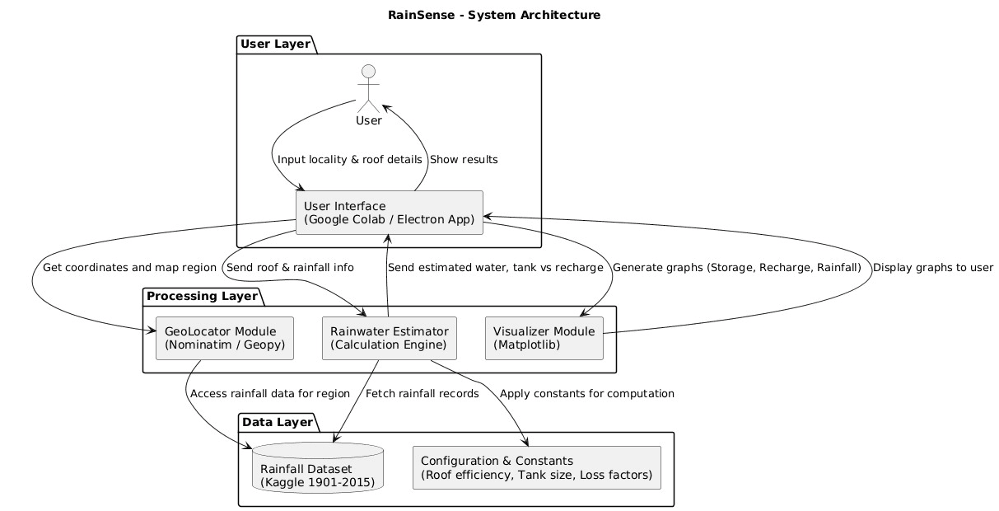
System Architecture
Explanation:
The system architecture diagram illustrates how user inputs (locality and roof details) pass through a multi-layered pipeline involving an interface, geolocation mapping, rainfall estimation, and data visualization, ultimately providing accurate water harvesting estimates and graphical summaries.
It also shows the separation of responsibilities across user, processing, and data layers, with each module accessing either the rainfall dataset or configuration constants as needed for efficient computations and outputs.

Slide 9
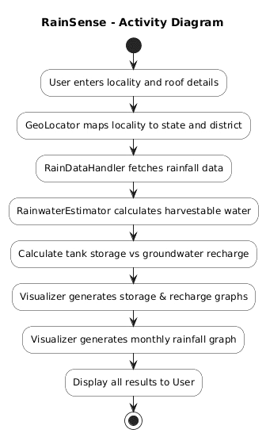
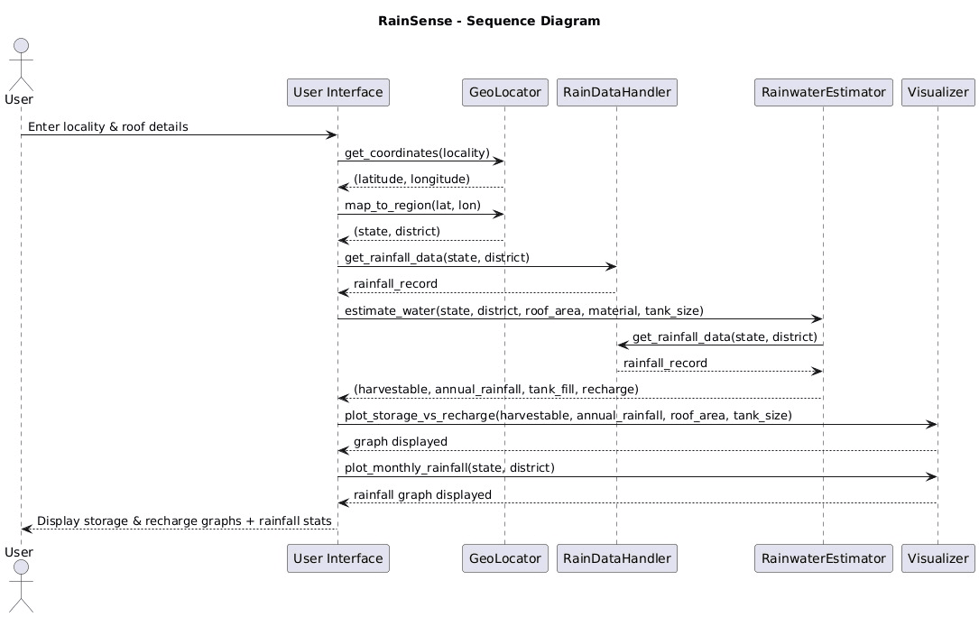
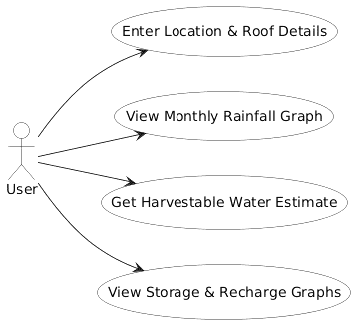
Usecase and Other Diagrams
Activity Diagram
Usecase Diagram
Sequence Diagram

Slide 10
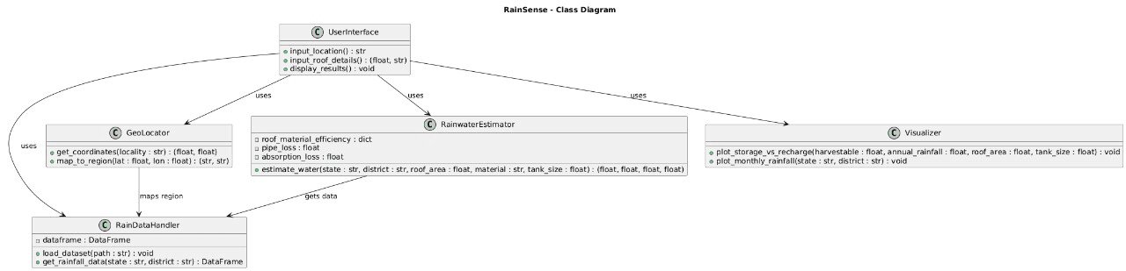
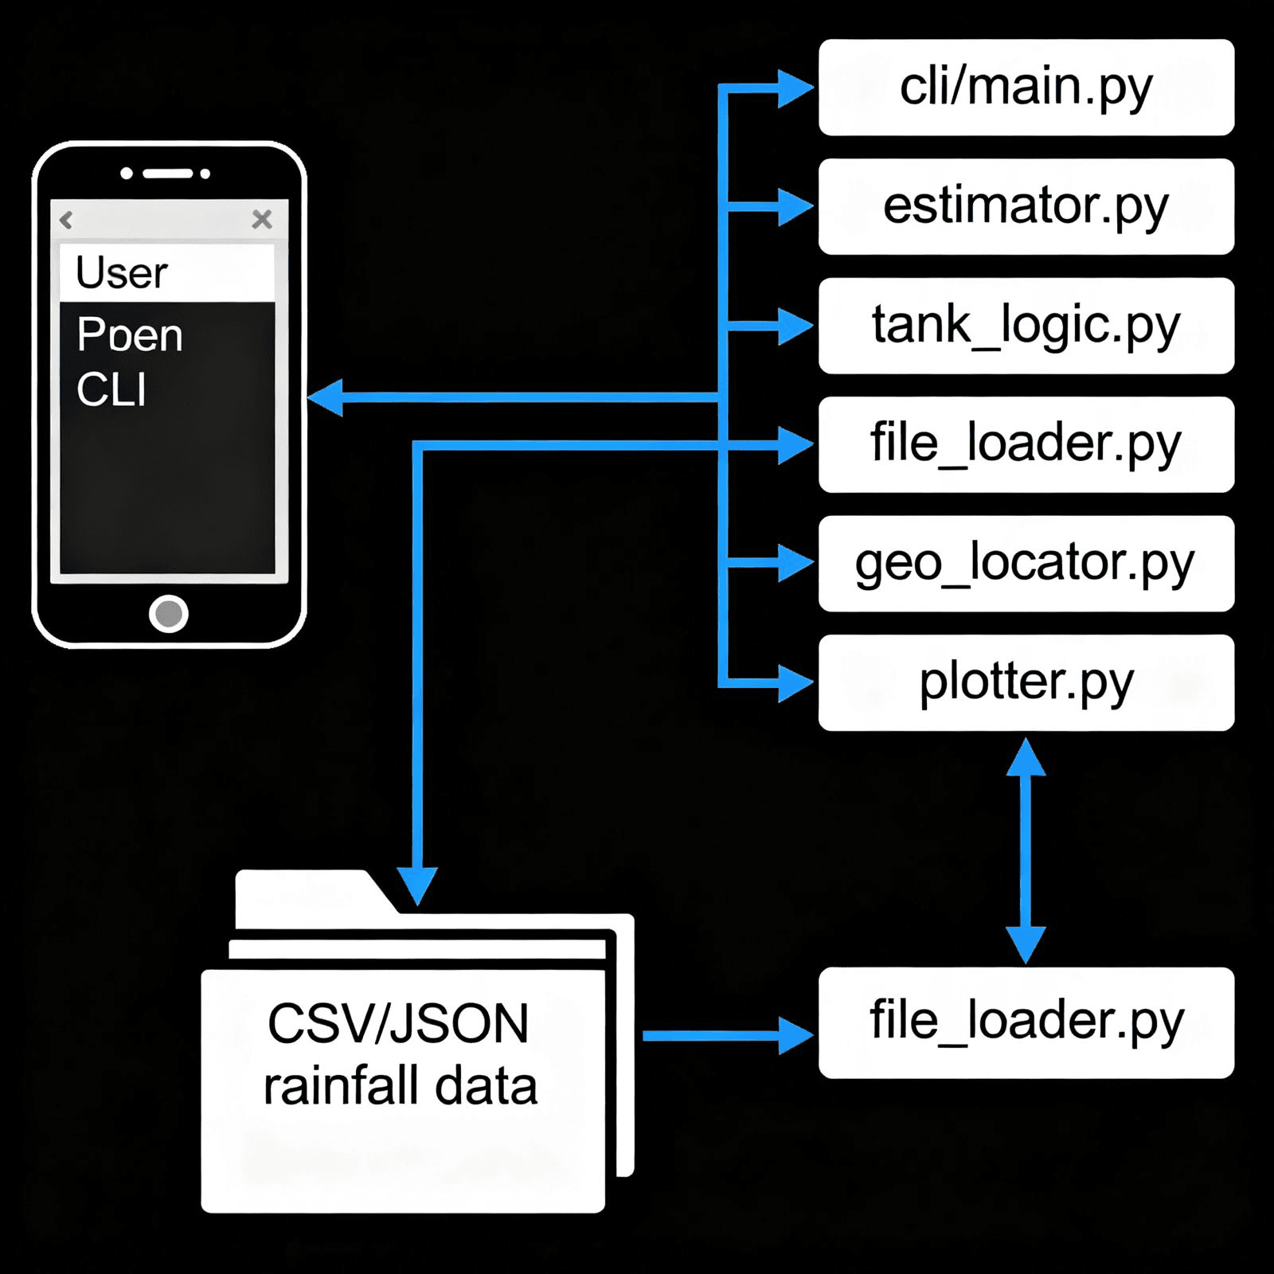
Usecase and Other Diagrams - Contd.
Class Diagram
Deployment Diagram

Slide 11
Modules
data_loader.py: - Responsible for loading and preprocessing rainfall datasets in CSV or JSON format. - Makes region-specific rainfall data accessible and ensures data integrity for subsequent calculations.
estimation.py: - Implements the primary calculation logic for rooftop rainwater harvesting estimation. - Uses rainfall values, roof information, and fixed efficiency constants to compute harvested water and recharge estimates.
geo.py: - Handles mapping and translation of user-provided locality details into region indices or codes required for correct dataset lookup. - Facilitates accurate retrieval of regional rainfall data.
plotting.py: - Generates visual summaries, such as monthly and annual bar charts, for harvested water, tank usage, and recharge statistics. - Improves clarity and interpretability of estimation results for the end-user.
main.py: - Serves as the command-line application’s entry point and coordinator. - Orchestrates user interaction, manages workflow between modules, and handles input validation and error management.
setup.py: - Enables packaging and installation of the CLI app as a Python module. - Ensures all project dependencies are tracked and the CLI command is registered for user access.
Inter-module interaction: - User input from main.py is validated and processed, then geo.py determines the relevant region. - main.py calls data_loader.py to retrieve the required rainfall data for that region, then estimation.py performs calculations using this data and system constants. - Upon request, plotting.py is invoked by main.py to visualize the results.

Slide 12
Algorithm/Methodology
• Dataset Integration
– Uses preprocessed rainfall datasets (CSV or JSON) indexed by location (district, city, or coordinates)
– Maps user-provided location to corresponding rainfall entry
– Validates field formats and units to maintain data consistency
• Parameter Initialization
– Loads predefined constants such as roof material efficiency, pipe loss, and absorption rate at startup
– Assumes standard values for roof area and tank capacity if not specified
• Main Estimation Algorithm
– Retrieves total rainfall for the selected location and period
– Calculates raw water volume: Raw Volume (L) = Rainfall (mm) × Roof Area (m²)
– Applies efficiency coefficients: Effective Harvest (L) = Raw Volume × Material Efficiency × Pipe Loss × Absorption Loss
• Tank and Recharge Handling
– Compares calculated harvest with standard tank capacity
– Assigns up to tank capacity for storage; computes surplus as potential groundwater recharge
• User Interface Flow
– Accepts user inputs (location, optional roof material/area)
– Handles data retrieval, estimation, and output via a clear CLI interface
– Includes validation checks and user-friendly feedback for invalid inputs
• Visualization
– Generates bar or line plots of monthly or yearly harvested water volumes (matplotlib/seaborn)
– Enhances result interpretation and visual clarity

Slide 13
Testing
• Unit Testing of Core Modules
– All major computational modules, including estimation logic and tank handling, were validated through focused unit tests to ensure reliability and correctness.
• Validation Against Reference Data
– Harvesting estimates were verified using real-world rainfall and rooftop data.
– Results were benchmarked against known outcomes from published reports and field data.
• Automated Test Scripts
– Automated tests executed core calculation routines for both edge cases and typical scenarios.
– Error-handling and input validation were tested for robustness against invalid or missing data.
• Result Consistency Checks
– Outputs across multiple runs were compared to confirm consistency.
– Calculated values were validated manually and against alternative estimation tools.
• Code Quality and Documentation
– Codebase was modularized and well-documented for easier review and maintenance.
– Test cases and expected outcomes were archived to ensure transparency and reproducibility.
• User Experience Testing
– CLI workflow was tested iteratively for clarity of prompts, ease of input handling, and user feedback quality.

Slide 14
Performance Analysis
• Execution Speed
– RainSense performs estimations within seconds for a single location.
– Uses preprocessed datasets (CSV/JSON) for fast data loading and lookup.
• Resource Utilization
– Maintains low memory and CPU usage, efficient on standard systems.
– Modular structure allows future optimizations and parallel processing.
• Scalability
– Scales smoothly from single to multiple locations.
– Easily integrates new datasets or regions without performance drops.
• Accuracy and Consistency
– Results align with standard rainwater harvesting benchmarks.
– Consistent use of validated constants ensures scientific accuracy.
• Error Handling
– Strong input validation and exception control prevent crashes.
– User guidance messages ensure smooth corrections and stable runs.
• Extensibility
– Core modules ready for integration with real-time data feeds.
– Future upgrades can enhance analytics without affecting speed.

Slide 15
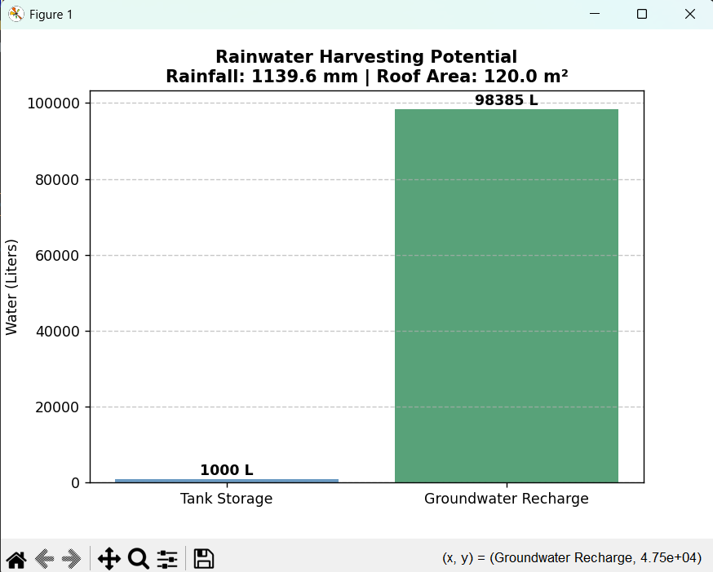
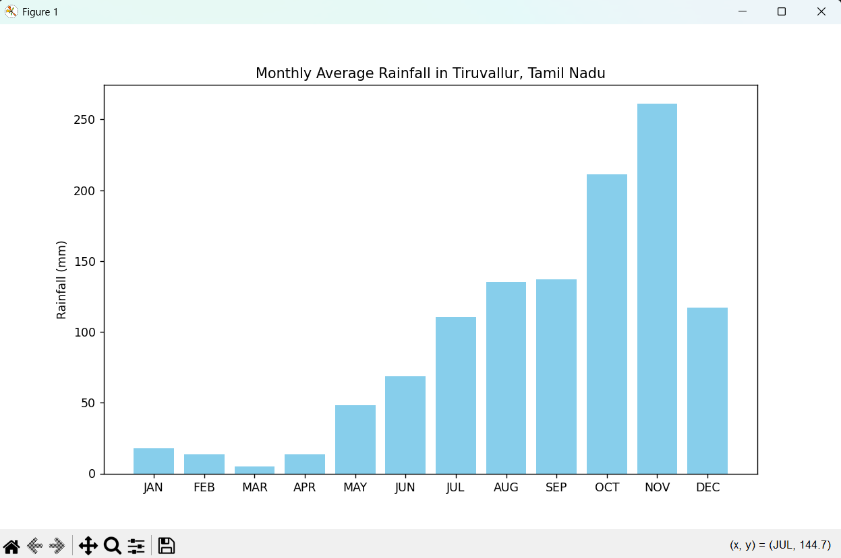
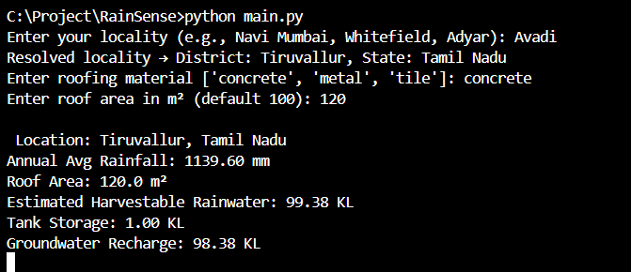
Screenshots

Slide 16
Conclusion
• RainSense stands as a novel, data-driven CLI framework designed to estimate rooftop rainwater harvesting potential with accuracy and repeatability.
• By seamlessly integrating real-world rainfall datasets with fixed physical and efficiency constants, the system ensures standardized and reliable estimations across diverse regions.
• It effectively bridges the gap between traditional manual calculations and modern digital analysis, making sustainable water estimation more accessible and consistent.
• With its modular design and extendable architecture, RainSense can easily evolve — incorporating new datasets, parameters, or real-time data sources.
• The tool empowers individuals, organizations, and policymakers to make informed decisions that support sustainable water management and conservation.
• Overall, RainSense demonstrates how computational methodologies can transform environmental analysis into a practical, transparent, and actionable solution for a sustainable future.

Slide 17
Future Scope
• Batch-Mode Analysis
- Extend RainSense to process multiple locations at once, enabling large-scale comparative studies and multi-region analysis.
• Real-Time and Forecast Data
- Integrate with rainfall APIs to provide live or predictive estimations, helping users plan storage and usage more effectively.
• Cloud-Based Deployment
- Host RainSense on the cloud for accessibility, scalability, and collaborative use in urban or institutional planning.
• IoT-Driven Monitoring
- Incorporate IoT sensors to track rainfall, roof runoff, and tank levels in real time, enabling adaptive estimation and automation.
• Machine Learning Integration
- Introduce predictive models that learn from historical data to forecast future harvesting potential with greater accuracy.

Slide 18
References
[1] S. Reddy and A. Kumar, “Feasibility of utilizing rooftop rainwater harvesting to decrease urban dependence on conventional water sources,” J. Water Resour. Manag., vol. 32, no. 7, pp. 2151–2165, 2018.
[2] P. Sharma, R. Verma, and K. Singh, “Assessment of rainwater harvesting systems in semi-arid regions,” Environ. Sustain. J., vol. 14, no. 3, pp. 120–132, 2019.
[3] J. Thomas and L. Andrews, “Role of rooftop rainwater harvesting in sustainable urban water management,” Int. J. Environ. Stud., vol. 77, no. 5, pp. 687–701, 2020.
[4] S. Meena and R. Jain, “Importance of rainwater harvesting for sustainable urban development in Indian cities,” Urban Water J., vol. 15, no. 2, pp. 110–123, 2018.
[5] A. Chatterjee, P. Das, and S. Sen, “Efficiency testing of rooftop rainwater harvesting systems in Eastern India,” Water Conserv. Res., vol. 21, no. 4, pp. 45–56, 2017.
[6] M. Patel and V. Sinha, “Viability of rooftop rainwater harvesting in residential buildings,” J. Build. Eng., vol. 8, pp. 112–119, 2016.
[7] R. Bhatia and P. Kumar, “Cost-benefit analysis of rooftop rainwater harvesting systems,” Sustain. Water Resour. Manag., vol. 5, no. 1, pp. 75–84, 2019.
[8] A. Singh, “Water conservation using rooftop rainwater harvesting,” Int. J. Water Resour. Dev., vol. 31, no. 3, pp. 421–432, 2015.
[9] R. Sharma and S. Verma, “Application of rainwater harvesting in urban water management practices,” Water Policy J., vol. 20, no. 6, pp. 1032–1045, 2018.
[10] Kaggle Dataset, “Rainfall in India - Sub-division wise monthly data for 115 years (1901–2015),” [Online]. Available: https://www.kaggle.com/datasets
[11] Nominatim Geocoding API, [Online]. Available: https://nominatim.org
[12] Base Paper – “Rooftop Rainwater Harvesting System – A Solution for Water Scarcity: A Review” Authors: Rodrick Lepcha, Sanmay Kumar Patra, Ratneswar Ray, Sukram Thapa, Deewaker Baral, Sutanwa Saha

